Slide 1
GIET UNIVERSITY GUNUPUR TEXT SENTIMENTAL ANALYSIS
Name of the Supervisor (Dr.Premansu S. Rath)
Name of the Student(s) with Regd. No.:
Anshuman Pattnaik(1901060016)
Khitish Kumar Mishra(1901060027)
A.Himadri Prasad Achary(1901070008)

Slide 2
Presentation Outline
Introduction
Problem Definition
Project Overview/ Specifications
Hardware Specifications
Software Specifications
Literature Survey/ Background Details
Existing System
Proposed System
Feasibility Study of the Proposed System
Requirement Description
Use Case Diagram
System Analysis and Design
Sequence Diagram
Results and Outputs
Forms/ Menu/ Sub Menus
Reports
Conclusion
Uniqueness of Proposed System
Limitations of Proposed System
Future Scope of Proposed System

Slide 3
Introduction
Problem Definition
A basic task in sentiment analysis is classifying the polarity of a given text at the document, sentence or feature/aspect level- whether the expressed opinion in a document, a sentence or an entity feature/aspect is positive, negative or neutral.
Project Overview/ Specifications
Sentiment analysis steps are deeply intrinsic, comprising many different machine learning and NLP tasks and subtasks such as data collection,data preprocessing,data analysis,data visualization.

Slide 4
Introduction
Hardware Specifications
Windows laptop with minimum Intel core i3
At least 2GB ram
Windows 10
Software Specifications
Django
Dataset - twitter_sample
Python 3.0 or above
NLTK package

Slide 5
Literature Survey/ Background Details
Existing System
Title : Efficient Twitter Sentiment Analysis System with Feature Selection and Classifier Ensemble Author(s) : Mohammed Mamdouh Fouad,Tarek F Gharib,Abdulfatah S Mashat
Year : 2018
Title : A Comparative Study of Amazon Product Reviews Using Sentiment Analysis Author(s) : Ansh Gupta, Aryan Rastogi, Avita Katal
Year : 2021

Slide 6
Literature Survey/ Background Details
Proposed System
This would be our model based out of logistic regression which would help us differentiate on type of content.
Feasibility Study of the Proposed System
This project can be used to propose an ideal model which can identify specific interest, sentiment or we can say idea in terms of specific subject of texts. and it can be very helpful in getting real sentiments of bunch of people in platform like twitter ,quora which will help individuals to make better decision regarding product review or understanding the sentiment of society on specific topic.

Slide 7

Requirement Description
Use Case Diagram
Sentimental Analysis
USER

Slide 8
System Analysis and Design[2]
Sequence Diagram
Importing library
Dataset download
tokenization
Word frequency count
Train model
Sigmoid
function
L R function
Split dataset
positive
validate
train
test
classify
negative
accuracy

Slide 9
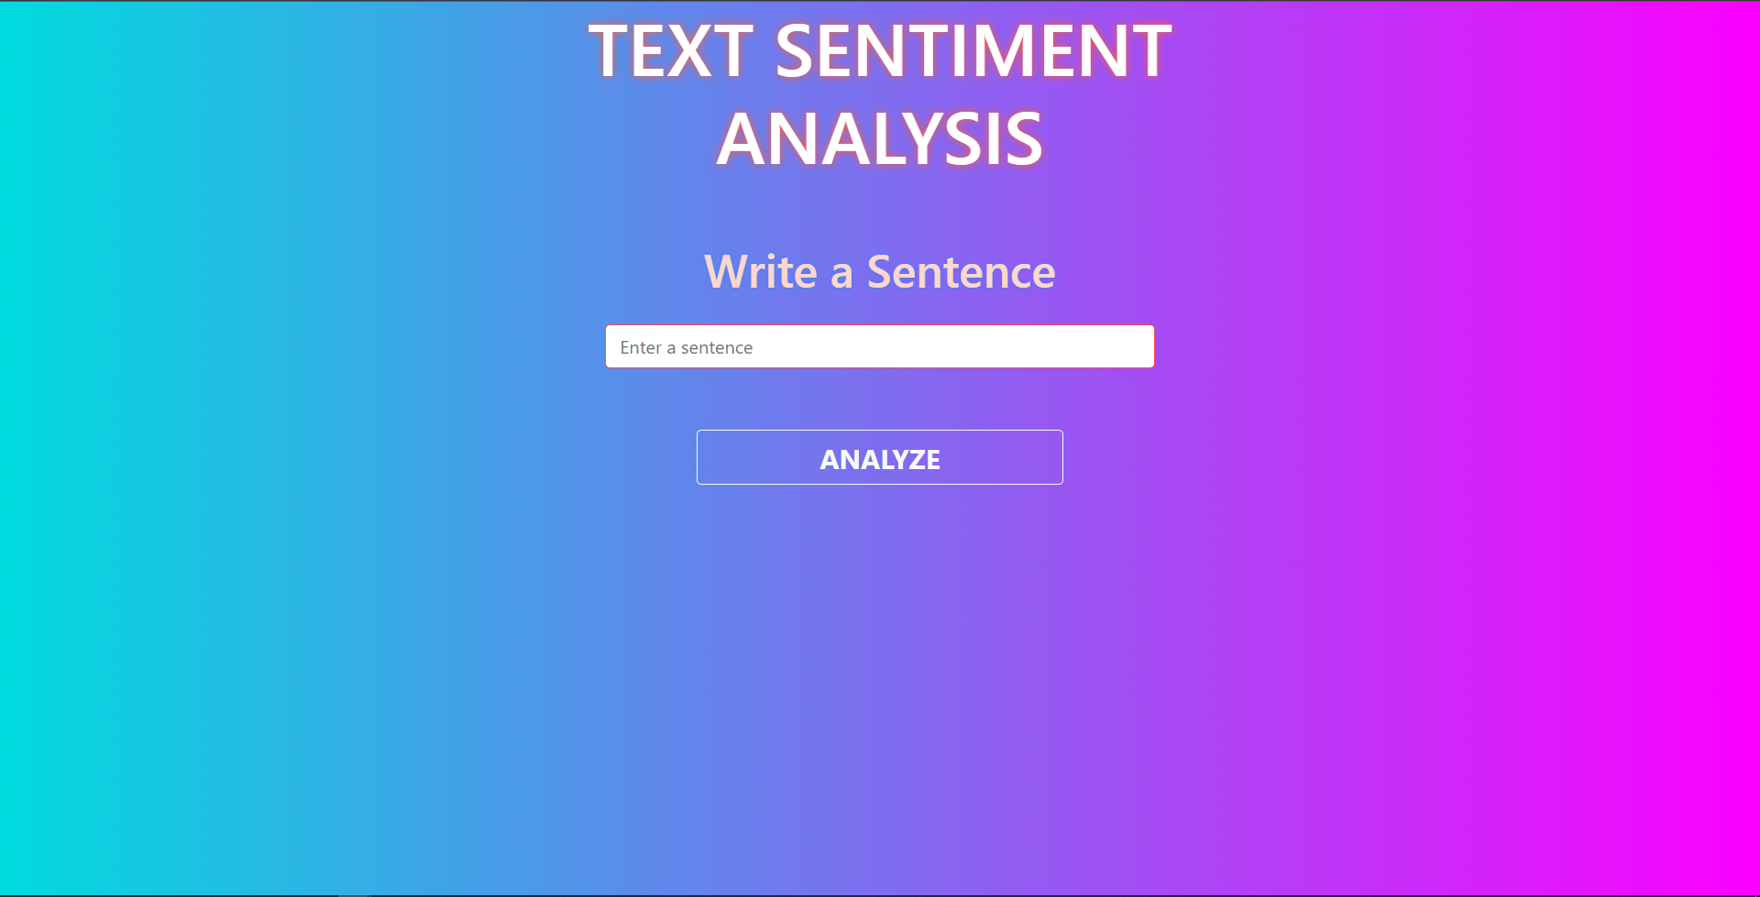
Results and Outputs[1]
Forms/ Menu/ Sub Menus

Slide 10
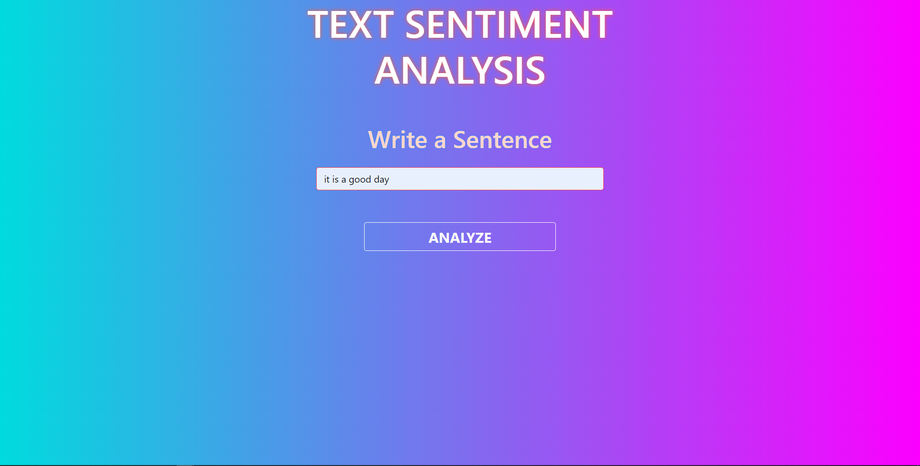
Results and Outputs[2]
Forms/ Menu/ Sub Menus

Slide 11
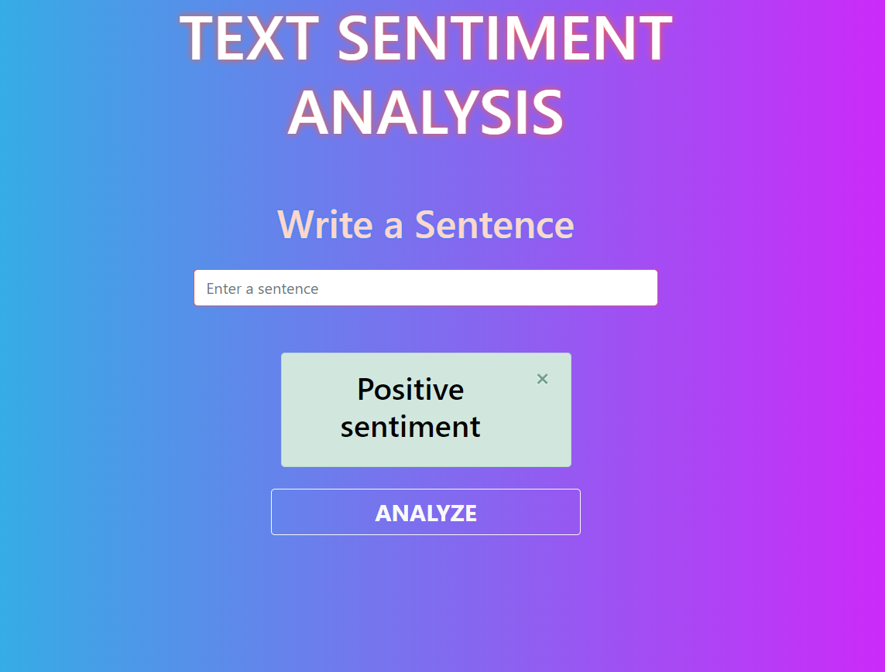
Results and Outputs[3]
Reports

Slide 12
Conclusion
Uniqueness of Proposed System
Data preprocessing
Logistic regression
Classification of text into its tone(positive or negative)
Limitations of Proposed System
Logistic regression doesn’t let us know which text is neutral because the probability of neutral words lies on the line of 0.5 which is very difficult to detect.

Slide 13
Conclusion
Future Scope of Proposed System
Sentiment analysis will advance to include and appreciate the significance of social media conversations and what they tell about consumers in the future, going beyond the idea of the quantity of likes, comments, and shares on a piece.
It can be setup as a third party plugin which will help to filter out spam/hate/unnecessary contents harmful for audience.

Slide 14
References
lit dataset
Tyagi, A., & Sharma, N. (2018). Sentiment analysis using logistic regression and effective word score heuristic. International Journal of Engineering and Technology (UAE), 7(2.24), 20-23.
Stine, R. A. (2019). Sentiment analysis. Annual review of statistics and its application, 6, 287-308.

Slide 15


